Slide 1
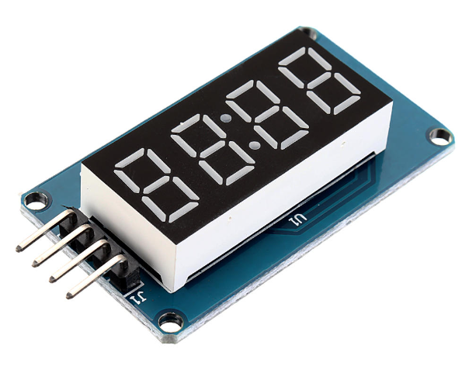
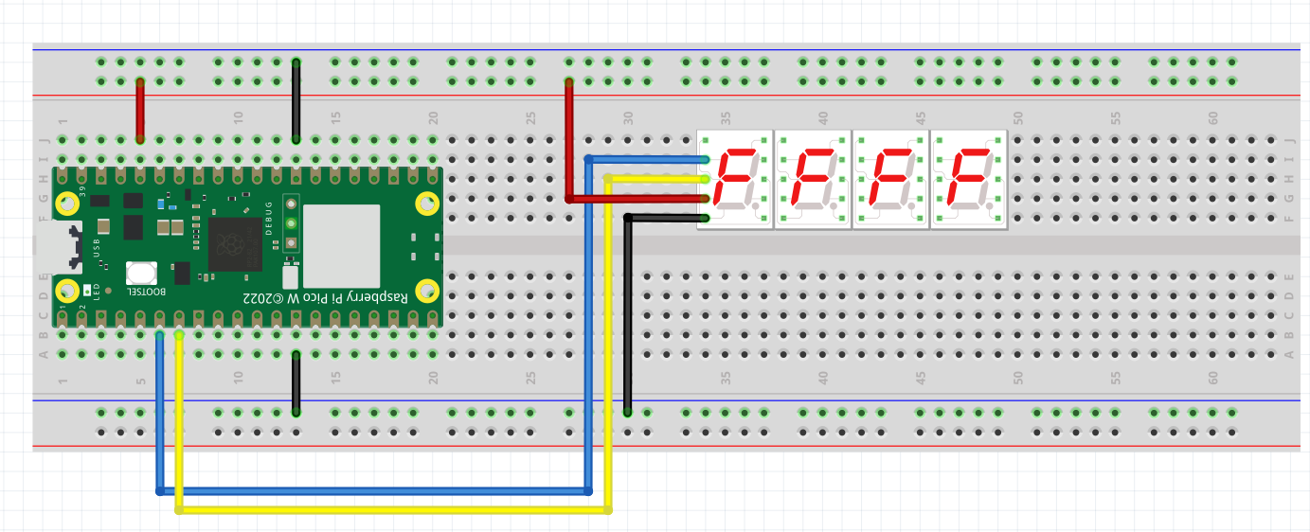

THE TM1637 7-SEGMENT DISPLAY

Slide 2
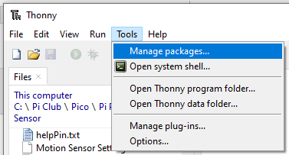
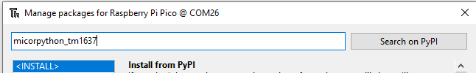
This component requires a special python library to run
Connect the Pico to the Laptop
Launch Thonny
Select the Interpreter / Com Port
And
Follow these steps to download this library
Library/Package : micropython-tm1637
Step #1 Click Tools and Select Manage packages

Slide 3

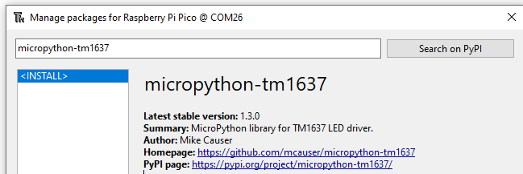

Step #2 Enter the package name in the search box - micropython_tm1637
Click the Search on PyPi button
Step #3 Click micropython-tm1637 link to download and install the library/package.
Step #4 Click Install

Slide 4
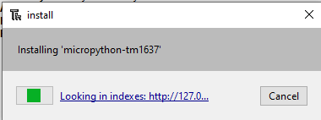
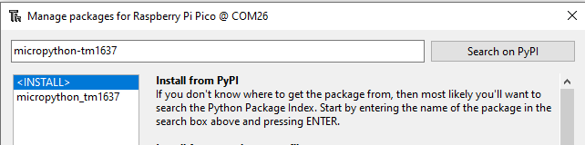


You will see the installation Progress Bar
Once the installation is complete, the package will appear on the left pane as shown below
Click Close
You will see the tm1637.py package/library under the folder lib

Slide 5
You can now test the 7 Segment Display in the shell >>>
>>> from machine import Pin
>>> import tm1637
>>> tm = tm1637.TM1637(clk=Pin(4), dio=Pin(5))
>>> tm.show(“HELP”)
>>> tm.number(1234)
>>> tm.number(99)
Create a count up display in the editor and save it as test.py
import tm1637
from machine import Pin
tm = tm1637.TM1637(clk=Pin(5), dio=Pin(4))
for x in range(1,11,1):
tm.number(x)
Create a count down display
For more examples: https://github.com/mcauser/micropython-tm1637
Click tm1637_test.py to view more examples

Slide 6
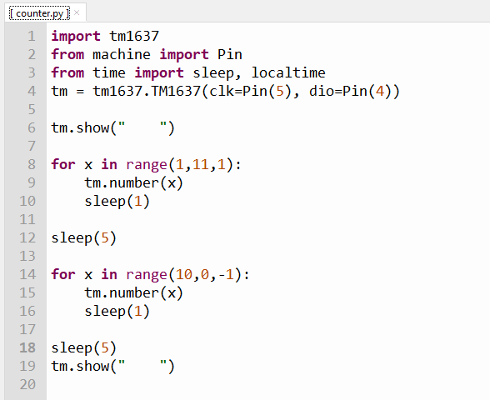
UNDERSTANDING FOR LOOP
SOLUTIONS TO EX 1
* Revision
Clear display
Python for loop for counting 1 to 10 in increment of 1.
It must end with 10 + increment. In this case it is 10+1 = 11
Python for loop for counting 10 to 1 in decrement of 1 (i.e. -1).
It must end with 1 - decrement. In this case it is 1-1 = 0

